Slide 1
Regression Discontinuity Design Project
Concordia Bootcamps, CB-DS-17
Presentation by: Neil Aucoin

Slide 2
References
1- Government of Canada
2- Montreal Gazette
3- World Health Organization
Notes:
- https://open.canada.ca/data/en/dataset/261c32ab-4cfd-4f81-9dea-7b64065690dc
- https://open.canada.ca/data/en/dataset/261c32ab-4cfd-4f81-9dea-7b64065690dc/resource/39434379-45a1-43d5-aea7-a7a50113c291
- https://montrealgazette.com/news/local-news/covid-19-timeline-a-year-like-no-other-in-quebec
- https://www.who.int/emergencies/diseases/novel-coronavirus-2019/interactive-timeline#!

Slide 3
Contents
COVID Statistics (Cases)
Total cases over last 7 days
Total cases over last 14 days
Average cases over last 7 days
Notes:
Data found from Government of Canada Public Health Infobase
- Chose COVID cases as my metric since changes in data should be easily observable and directly correlated to the chosen cutoffs (make it easier to see if my data makes sense and make impacts of cutoffs obvious)
- Chose three metrics of different significances in order to capture the effect of the cutoffs from multiple perspectives and timeframes (which will be easy to see visually in the following slides)
14 day metric is very volatile (immediate changes)
7 day cases is somewhat volatile (general overview)
7 day average is more tempered (better for long-term impacts)

Slide 4
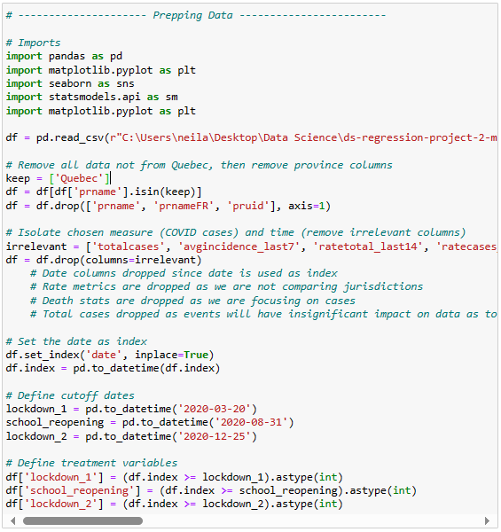
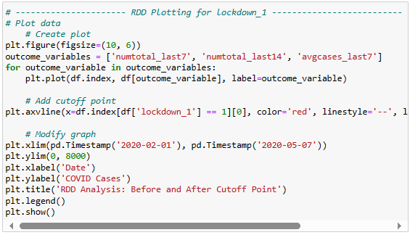
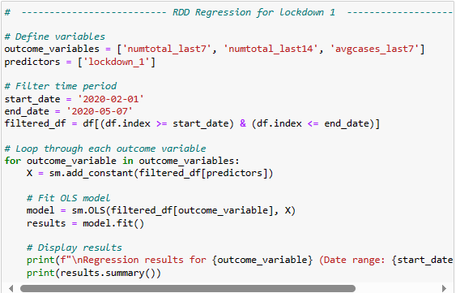
Process
Data Cleaning
Plotting
Regression
Notes:
Data cleaning:
Removed all information not directly relevant to my analysis to avoid overfitting model and to make data easier to interpret
Reduced to Quebec only
Reduced to non-population-related case data only
Changed date to datetime and set as index
Plotting:
- Plotted first to get an idea of the trends visually to know what to expect
- Used line graphs as data used was not daily, so points were too scattered to be interpreted in a meaningful manner with a scatter plot or less linear chart (also better for plotting multiple metrics)
Regression:
- I focused on one degree due to the linearity of my data
- This also helped to avoid overfitting and keep my data easy to interpret
- Degree 2 regression provided similar results

Slide 5
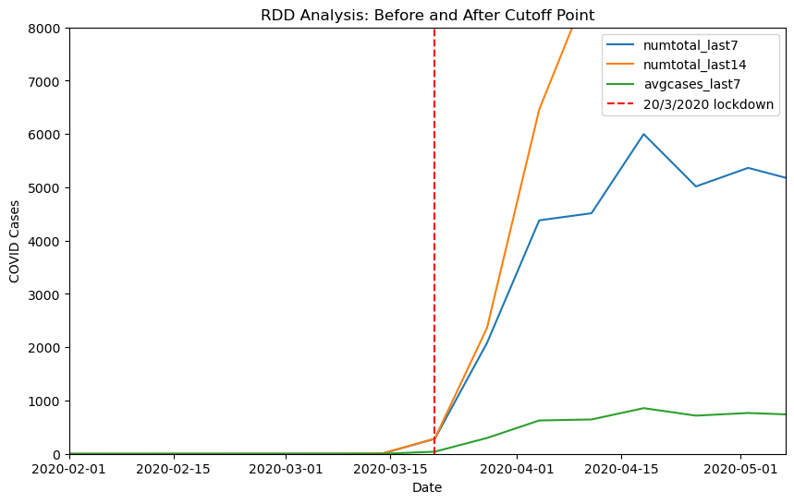
Lockdown 1
numtotal_last14
R-squared: 0.617
Coefficient: 7129.5714
P-value: 0.001
numtotal_last7
R-squared: 0.687
Coefficient: 3947.1429
P-value: 0.000
avgcases_last7
R-squared: 0.687
Coefficient: 563.8771
P-value: 0.000
Notes:
P-value below 0.05 indicates that the lockdown had a statistically significant impact on the number of cases
48 days (beginning of data to to cutoff, same length of time after)
- The data associated with the first lockdown on 20/3/2020 would indicate that the cutoff correlated with a significant increase in covid cases, and that the lockdown was a statistically significant factor in this (based on r-squared, p-values, and coefficients).
- However, we can reasonably assume this to be due to bias in our data, as the overall covid cases were very low prior to the cutoff since the pandemic had just started, and since the number of cases of a highly transmittable virus are likely to increase exponentially regardless of the circumstances, we could consider the data to be unreliable and not necessarily representative of reality.

Slide 6
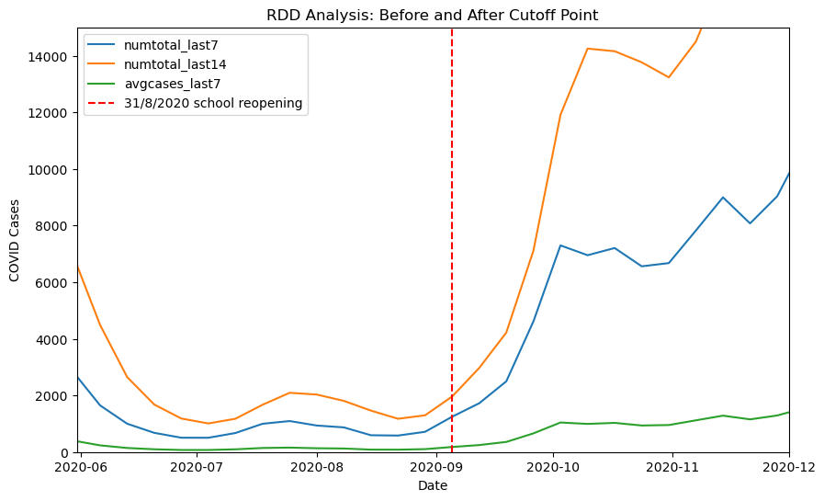
Schools Reopening
numtotal_last14
R-squared: 0.621
Coefficient: 9642.3846
P-value: 0.000
numtotal_last7
R-squared: 0.671
Coefficient: 5222.9231
P-value: 0.000
avgcases_last7
R-squared: 0.671
Coefficient: 746.1315
P-value: 0.000
Notes:
P-value of 0.00 all around indicates that the lockdown had a very statistically significant impact on the number of cases
Timeframe:
3 months (enough time to see trends before and after cutoff, not too much to see effect of other significant events (big spikes 4 months before and after)
- Used trial and error with chart to see significant trends before and after
- The data associated with schools reopening on 31/8/2020 would indicate that the cutoff correlated with a significant rise in covid cases. Our OLS regression results indicate that schools reopening was a statistically significant factor in this increase, and that the fact of schools reopening accounts for a large percentage of the reason covid cases increased at all (or as much as they did).
- Looking into the data several months before and after the cutoff shows us that the increase associated with schools reopening is likley not simply due to normal fluctuations in covid cases, as cases reported had decreased significantly in the months prior to the cutoff, and continued to increase significantly for several months after the cutoff.

Slide 7
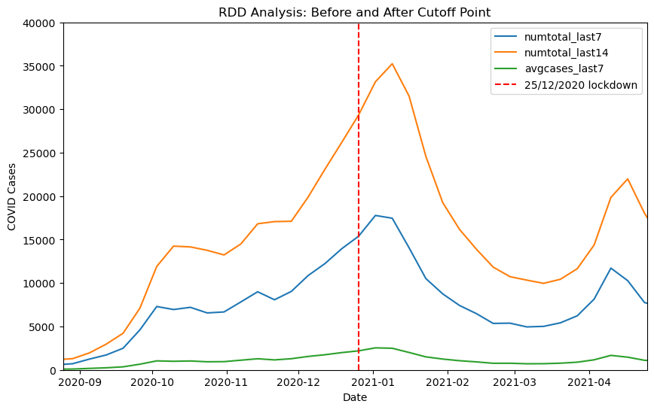
Lockdown 2
numtotal_last14
R-squared: 0.136
Coefficient: 6105.2582
P-value: 0.030
numtotal_last7
R-squared: 0.091
Coefficient: 2486.9739
P-value: 0.079
avgcases_last7
R-squared: 0.091
Coefficient: 355.2818
P-value: 0.079
Notes:
- P-values above 0.05 for 7-day metrics but below 0.05 for 14-day metric indicate that the lockdown did not have a statistically significant effect in the first week, but did have an impact in the following weeks
- Lockdown 2: 4 months (same justification as school reopening)
- Used trial and error with chart to see significant trends before and after cutoff
- Our OLS regression results for this data mostly indicate that the second lockdown was not a statistically significant factor in the change in covid cases, due to the low r-squared and high p-values. The only concrete data we obtained here is for numtotal_last14, which indicates that the lockdown statistically correlated with an increase in covid cases
- However, looking at the data visually, we can see that a few weeks after the cutoff (around 10/1/2021), covid cases started to decrease rather significantly. This could indicate that the lockdown did have a significant impact on reducing covid cases, but that it took some time for the changes to take effect.

Slide 8
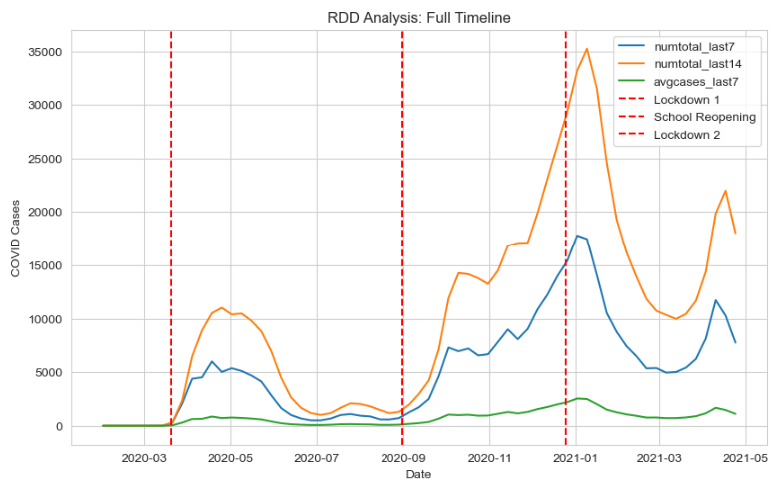
Timeline
New travel restrictions are implemented
Restaurant dining rooms are closed and gatherings are banned
Quebec allows gatherings of 250 people
Limited private gatherings can resume indoors
Quebec confirms its first presumed case of covid
Notes:
Very few cases before first cutoff = bias in data results
First covid case about a month before (Feb 27th)
Gatherings allowed just before schools reopening = also leads to increase
June 22 (restaurants, cinemas, theatres, uni classrooms)
Oct 1 - Montreal, Quebec City, and other regions become red zones; restaurant dining rooms close and gatherings are banned
- Travel restrictions not long after lockdown 2 = also leads to decrease
Jan 7 - negative covid test to enter
Feb 22 - 3 night quarantine on return

Slide 9
Assessment
I would assess it as likely that the initial lockdown on 20/3/2020 had little effect on curbing the rate of COVID cases in Quebec, although the true impact is difficult to measure
I would assess it as highly likely that schools reopening on 31/8/2020 caused a sharp increase in COVID cases in Quebec
I would assess it as likely that the second lockdown on 25/12/2020 had a moderate effect on reducing COVID cases in Quebec

Slide 10
Questions

Slide 11
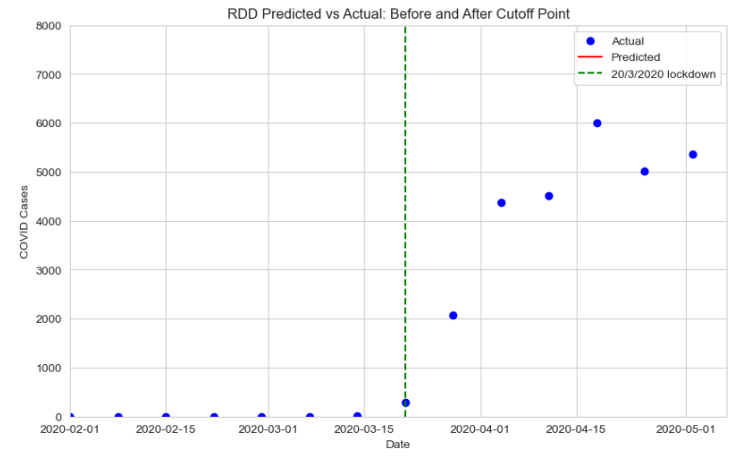
RDD Predicted vs Actual
Notes:
Data was too linear for scatter plots so I would’ve had to zoom out a lot to get any interpretable data or change datasets entirely. I felt using 3 metrics to compensate was enough to give us a good idea of what the data represented.
I also have experience working with more sparse datasets and analyzing data so I felt confident going forward with this data

